Slide 1

Parenting in the Age of Screens II – predictive Analytics
Data Analysis

Slide 2
Thoughts and Improvements
Data from the studies of child psychologists on smartphone usage
Technology usage in the pandemic for children
Felt it was difficult to do predictive analytics on data provided
Plan to add logistical regression comparing household income to a child’s smartphone usage

Slide 3
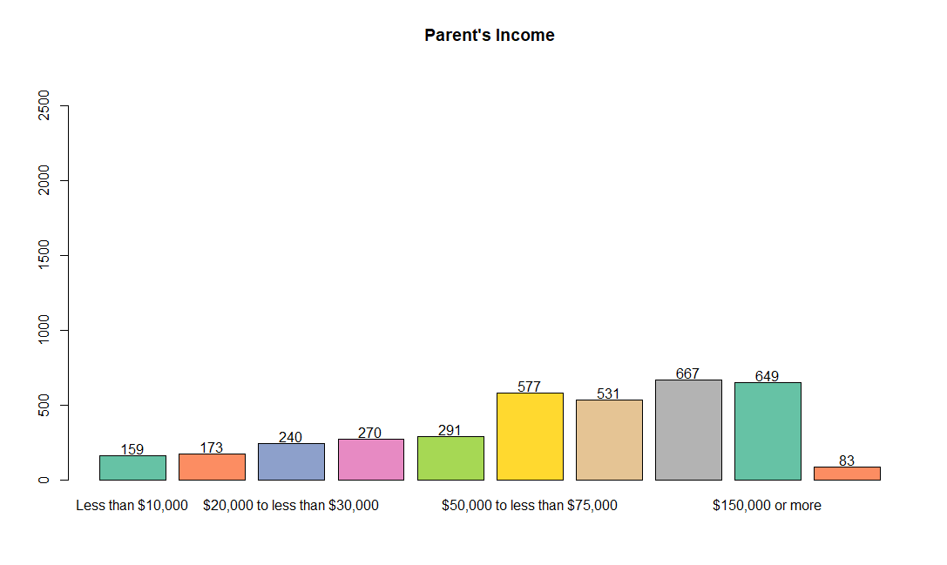
Parent’s Income Bar Chart
- Around 2/3 of the parents surveyed make more than $40,000 a year, the other 1/3 of parents surveyed make less than $40,000

Slide 4
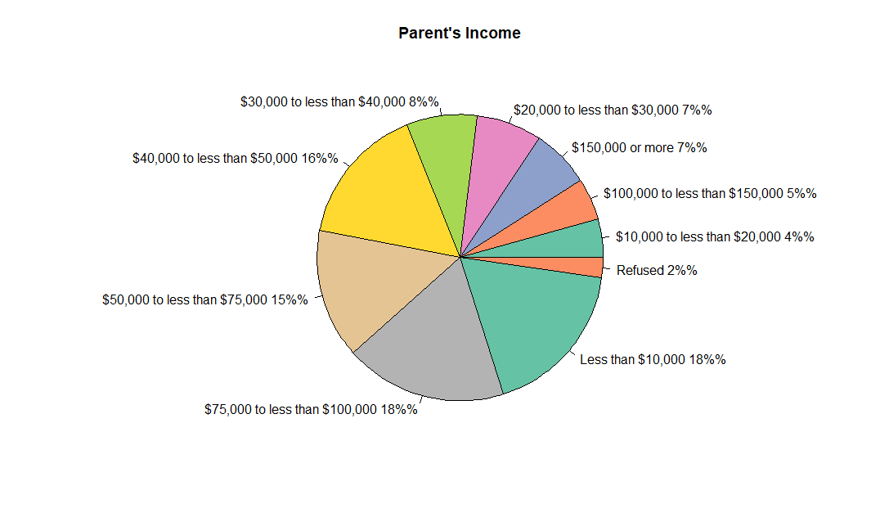
Parent’s Income Pie Chart
- Around 2/3 of the parents surveyed make more than $40,000 a year, the other 1/3 of parents surveyed make less than $40,000

Slide 5
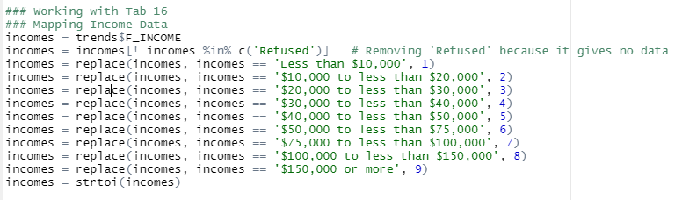
Mapping Data
Because I had categorical data I needed to transform the values to numerical data.
The easiest way was to map them to values 1-9, from those in the lowest income bracket to the highest income bracket in the survey

Slide 6
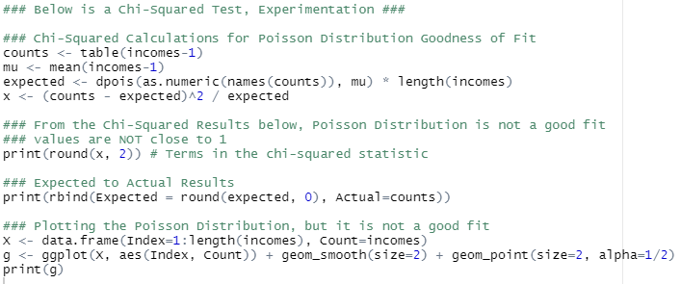
Attempting to find a distribution
Wasn’t sure what kind of distribution I wanted to analyze because I had categorical data that was mapped
Decided to try the Chi-Squared Test for a Poisson Distribution

Slide 7


Poisson not a good fit
Turns out the Poisson Distribution was not a good fit.
Chi-Squared results should ideally be close to 1, I had values close to 1000. Definitely not a good fit
Expected Vs. Actual results were also not consistently similar

Slide 8
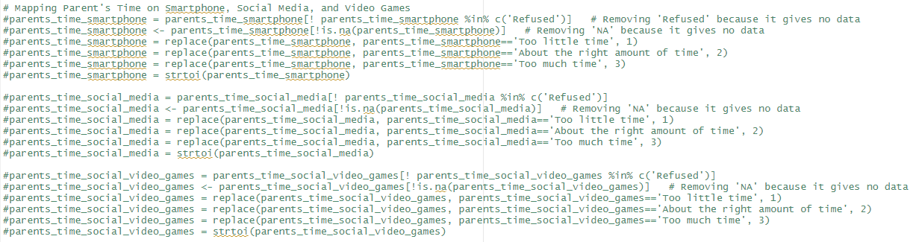
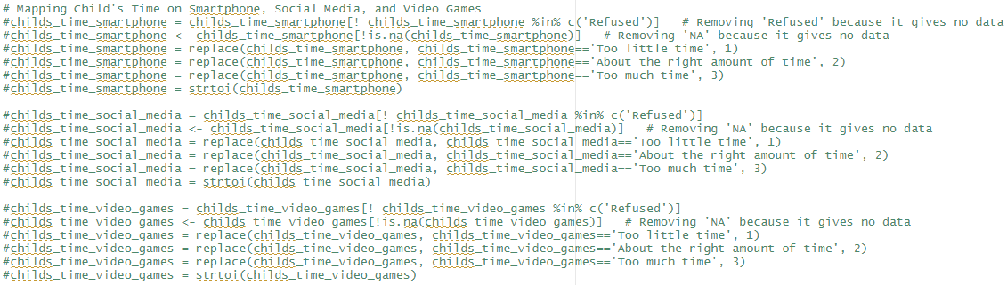
Working with R Vectors
Regardless of the analytics I wanted to do on my data, I needed to transform them
I also needed to deal with ‘Refused’ responses and ‘NA’/missing data

Slide 9
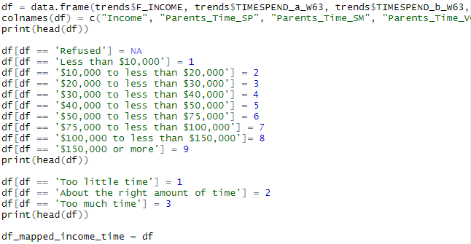
DataFrames
R DataFrames data structure is easier
Transformed ‘Refused’ data to ‘NA’
Transformed my income data for lowest income bracket to highest income bracket. Valued 1-9
Transformed my parent’s time usage and child’s time usage data of smartphones, social media, and video games. Valued 1-3

Slide 10
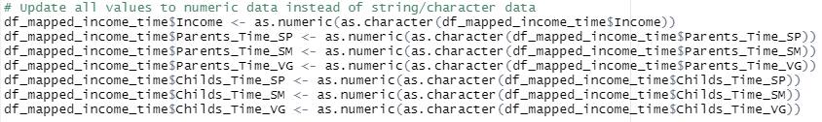
DataFrames
All values were still string values but I converted them into numerical data

Slide 11
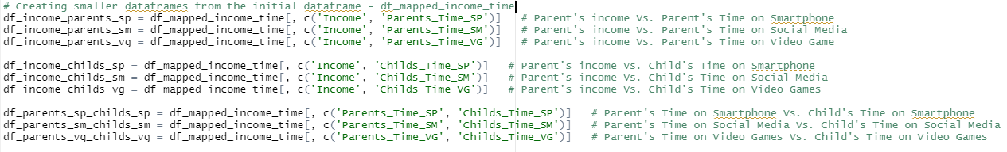
Using Sub-DataFrames
Thought it was better to isolate dataframes consisting of two columns for modeling

Slide 12
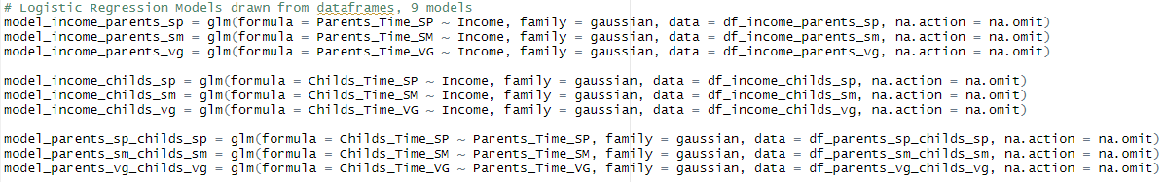
Logistical Regression
Decided to do logistical regression on my transformed data

Slide 13
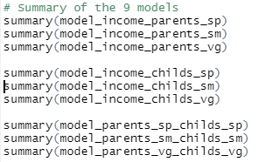
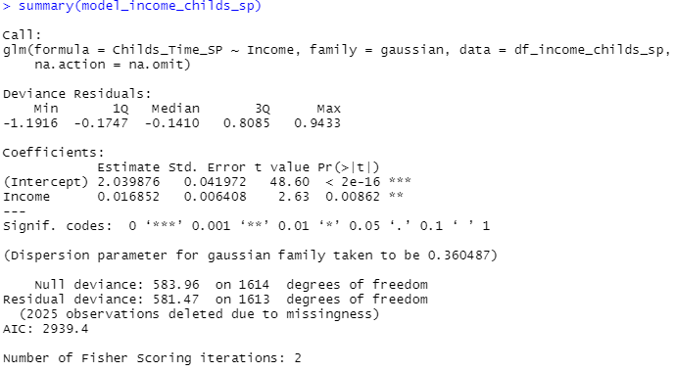
Summary of the Models
Example: Summary of the model with Parent’s Income vs. Child’s Time on the Smartphone

Slide 14
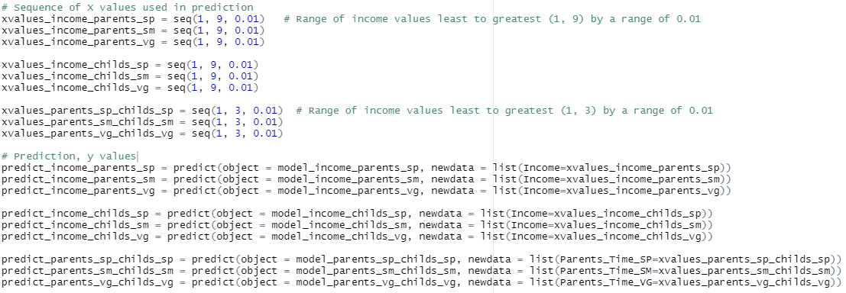
Prediction
Input values from the smallest value - 1 (income or time) to the greatest values 3 (time) or 9 (income) depending on the model

Slide 15
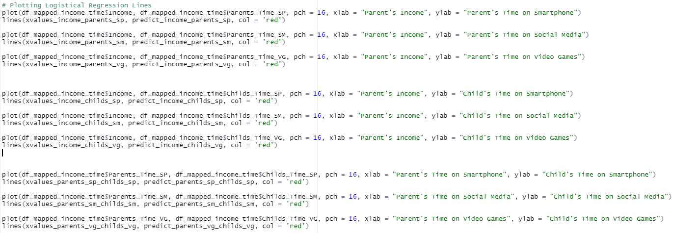
Plotting 1

Slide 16
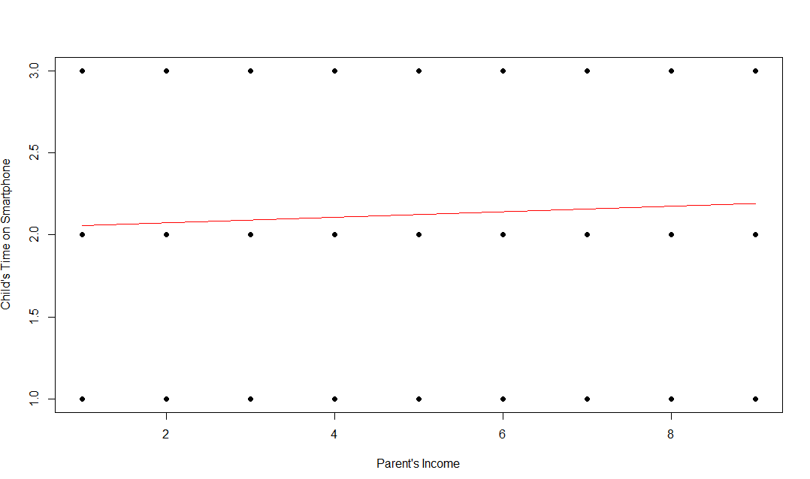
Plotting 2
Example: Parent’s Income vs Child’s Time on Smartphones
8 more plots in my code

Slide 17
Conclusion
Example: Parent’s Income vs Child’s Time on Smartphones
8 more plots in my code

Slide 18
Conclusion
1. It is difficult to decide what values to transform my categorical data to. 2. Logistical Regression is better for categorical data 3. Results of Predictive Analysis
# Parent's income Vs. Parent's Time on Smartphone – Positive, slight correlation
# Parent's income Vs. Parent's Time on Social Media – Positive, slight correlation
# Parent's income Vs. Parent's Time on Video Game– Positive, slight correlation
# Parent's income Vs. Child's Time on Smartphone– Positive, slight correlation
# Parent's income Vs. Child's Time on Social Media– Positive, slight correlation
# Parent's income Vs. Child's Time on Video Games– Positive, slight correlation
# Parent's Time on Smartphone Vs. Child's Time on Smartphone– Positive, slight correlation
# Parent's Time on Social Media Vs. Child's Time on Social Media– Positive, slight correlation
# Parent's Time on Video Games Vs. Child's Time on Video Games– Positive, slight correlation

